Slide 1
Welcome to AGL meeting
Status of UH/EAS
Hua-wei Zhou, UH/EAS
April 2, 2014

Slide 2
Welcome: Status of EAS
AGL – A great tradition since 1978
EAS news sampler
Faculty & facilities
Students

Slide 3
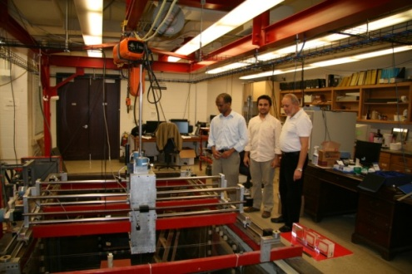
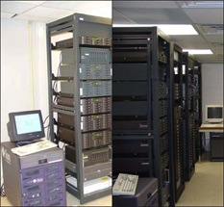
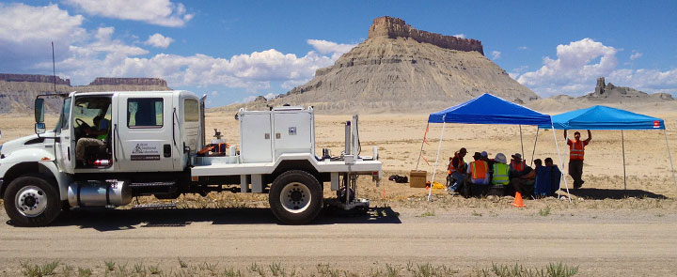
AGL – A great tradition since 1978
Physical (robotic) modeling
New recording electronics, piezo-pins and films
Laser-etched & 3D printed models, anisotropy, 4D
Field acquisition
Vibe truck (P & S), 240-channel Geodes, VSP, downhole source, well logging
CG-5 gravimeter, three GPR systems, Trimble GPS, Leica total station, Falmouth marine boomer, MicroEel streamer
Data processing & interpretation
GEDCO VISTA, Paradigm, SU, MATLAB, Hampson-Russell, SMT, Petrel, Landmark
Case histories
Meteor Crater, AZ; Sacramento, CA; Jemez Pueblo, NM; Elk Basin, MT
Pierce Junc., LaMarque, ERP, Blue Lagoon, Hockley, Galveston
Dickman, OK; Barnett, TX; Bakken, ND; Marcellus, PA; GoM
Tenerife, Colombia; Mexico; Haiti

Slide 4
Status of EAS: Recent news sampler
EAS has awarded 200 degrees in 2013 – An all-time record!
EAS continues hiring new faculty (now 3 searches in Exploration Geophysics, Sedimentary Geology & Geodynamics)
Kevin Burke, a EAS professor since 1983, will receive the 2014 Arthur Holmes Medal from the European Geoscience Union (EGU)
Will Sager, a EAS professor since 2012, was the leading author of a study that helped discover the largest single volcano on Earth
Jon Snow has his 11th Nature/Science paper recently
Robert Stewart, Shuhab Khan & Barry Lefer just won UH Teaching Excellence Awards

Slide 5
Status of EAS: Faculty & facilities
UH/EAS has 30 tenure-line professors, plus 20 research/adjunct professors.
Applied & Exploration Geophysics
Solid Earth Geophysics
Sedimentology & Stratigraphy
Structure & Tectonics
Geochemistry, Petrology & Hydrogeology
Atmospheric Science & Air Quality

Slide 6
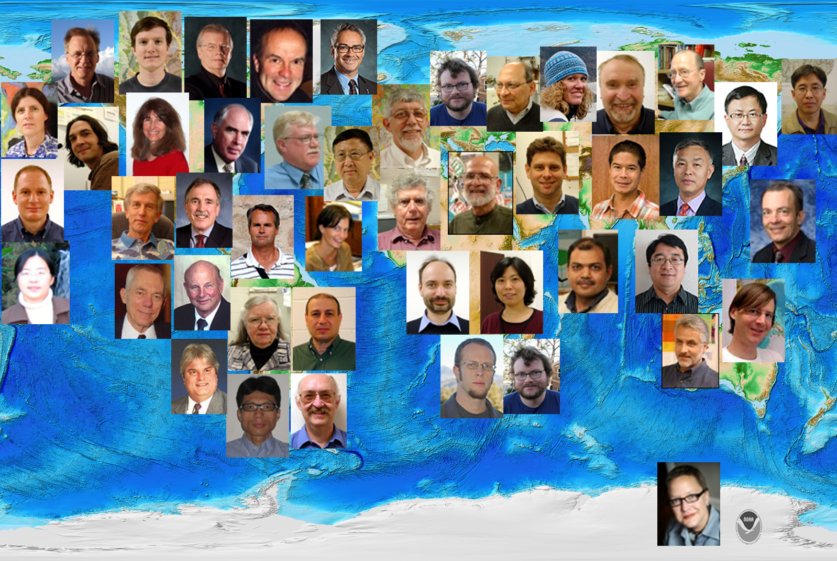
EAS faculty

Slide 7
EAS Geophysics faculty
Tenured faculty
Research & adjunct
faculty

Slide 8
EAS Research Expenditures
Research Expenditure [$]
Research Expenditure
IDC Expenditure
2007
2008
2009
2010
2011
2012
2013
Year

Slide 9
Leading EAS research facilities
Several world-class consortia & institutes:
Allied Geophysical Lab (AGL)
Caribbean Basins, Tectonics & Hydrocarbons (CBTH)
Rock Physics Lab (RPL)
Geochemistry Laboratories
Institute for Climate & Atmospheric Science (ICAS)

Slide 10
Status of EAS: Students
The largest Geosciences student body in the USA in 2013: >700 students: 96 Ph.D., 236 M.S., 418 B.S.
B.S., M.S. and Ph.D. in Geology, Geophysics, and Atmospheric Sciences
B.S. Degrees in Environmental Sciences & Earth Sciences
Professional M.S. Degrees in Geology & Geophysics

Slide 11
In the past 5 years EAS has awarded 577 degrees – the annual graduation # is tripled in 5 years!
EAS Degrees Awarded
Doctors
Masters
Bachelors
2007
2008
2009
2010
2011
2012
2013
Year
In 2013 EAS awarded 200 degrees: 75 Bachelors, 114 masters, and 11 doctors.

Slide 12
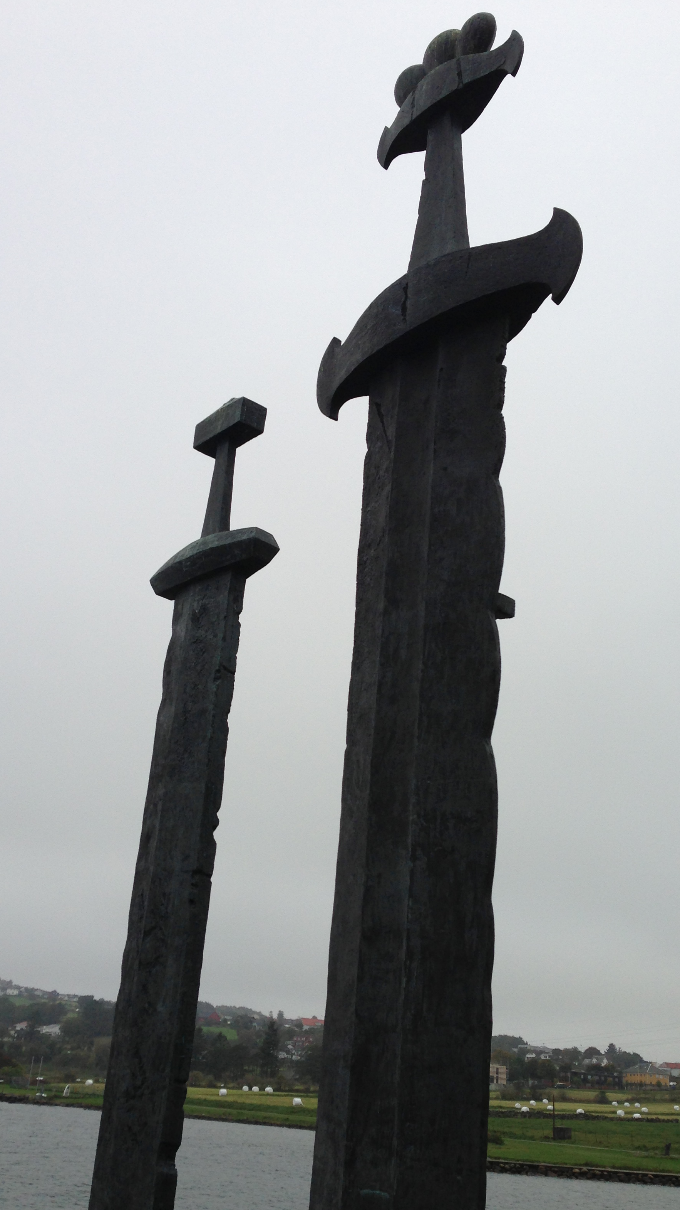
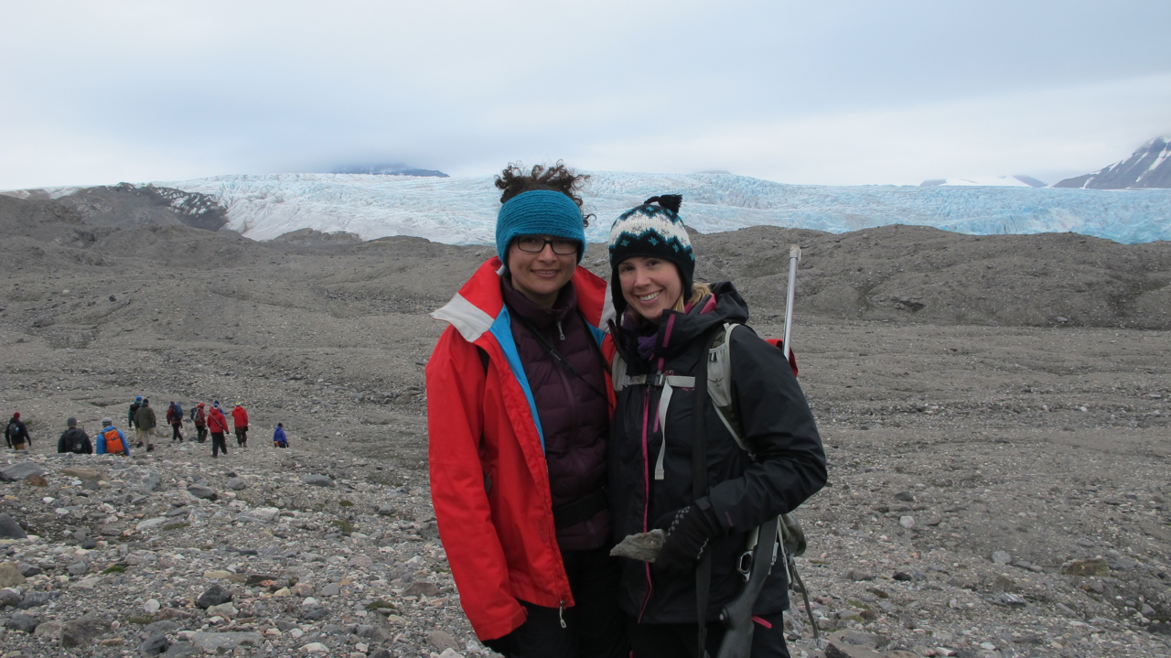
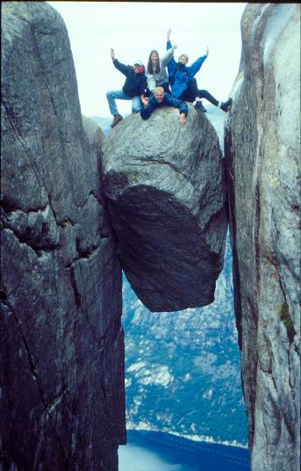
Advantages for EAS students
Many first-class faculty members
Proximity to the petroleum industry
Epicenter of both applied and pure geosciences
Many opportunities for international collaborations
2013 UH-UiS exchange students Yuribia Munoz and Jen Campo in Svalbard
University of Houston & University of Stavanger, Norway Student Exchange Program

Slide 13
Challenges & Solutions for EAS students
Major challenges:
Overwhelming student/faculty ratio
Reducing UH support to master students
Large bodies of part-time or international students
Some solutions:
Added Professional Geoscience program
Seeking more faculty & funding
Increasing admission standards
Upgrading curriculums and facilities
Emphasizing communication skills

Slide 14
Professional Geoscience Programs & Milestones
We will pass 80 graduates from the Professional Masters Program since 2008.
MS Cohort 14 in Petroleum Geology Started Fall 2013.
MS Cohort 15 in Petroleum Geophysics will start in Spring of 2014.
The Summer Geophysics Program will be in its 10th year.
Scheduling for the 5th Western Geco Area Geophysics University is underway.

Slide 15
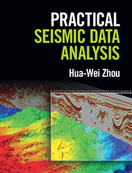
Finally, a list of my current research
Retrieving & use of low-frequency seismic signals
Reverse-time imaging of seismic sources
Deformable layer tomo-statics
Migration velocity analysis
Crustal seismology
Thank you!

